Slide 2
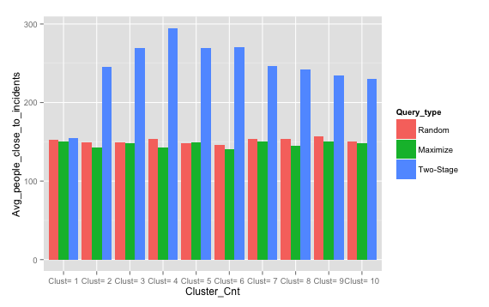
Close ≣ in KNN
K = 5
Incidnet_cnt = 100
Crowd_cnt = 100
Fist Stage = 0.2
T = 30
Two-Stage:
62.50% surge in comparison to Random
67.86% surge in comparison to Dispersion
Maximization

Slide 3
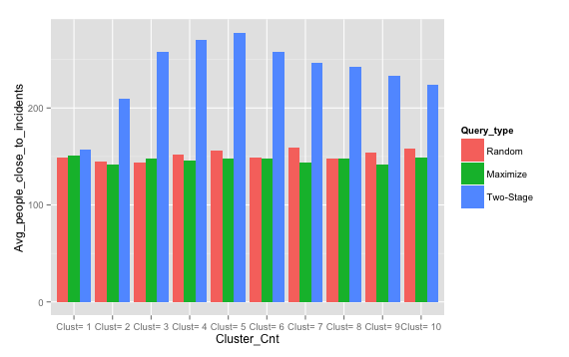
Close ≣ in KNN
K = 5
Incidnet_cnt = 100
Crowd_cnt = 100
Fist Stage = 0.4
T = 30
Two-Stage:
56.89% surge in comparison to Random
62.32% surge in comparison to Dispersion
Maximization

Slide 4
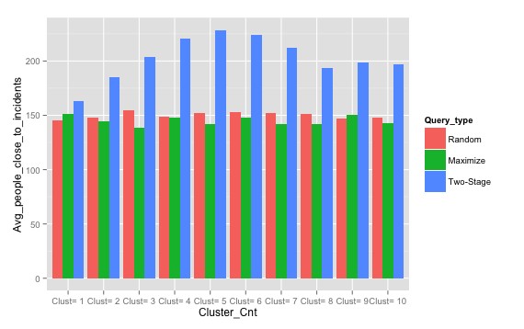
Close ≣ in KNN
K = 5
Incidnet_cnt = 100
Crowd_cnt = 100
Fist Stage = 0.6
T = 30
Two-Stage:
35% surge in comparison to Random
39.8% surge in comparison to Dispersion
Maximization

Slide 5
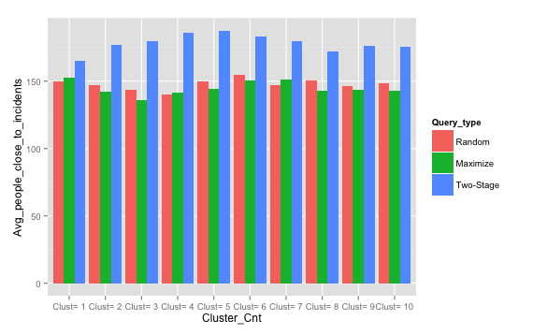
Close ≣ in KNN
K = 5
Incidnet_cnt = 100
Crowd_cnt = 100
Fist Stage = 0.8
T = 30
Two-Stage:
20% surge in comparison to Random
20.64% surge in comparison to Dispersion
Maximization

